Slide 1

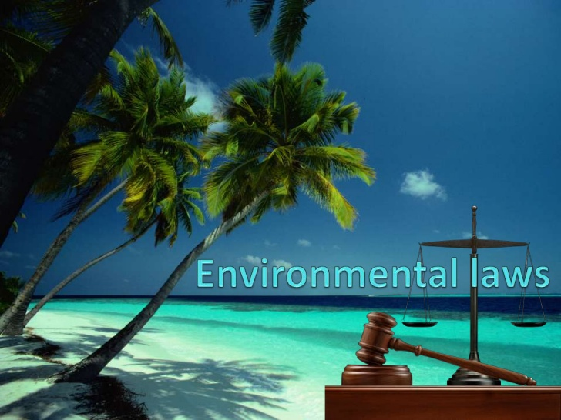

Environmental laws and legislations

Slide 2
Introduction
The Constitution of India clearly states that it is the duty of the state to ‘protect and improve the environment and to safeguard the forests and wildlife of the country’.
The Department of Environment was established in India in 1980. This later became the Ministry of Environment and Forests in 1985.

Slide 3
Introduction (Contd..)
The EPA (Environment Protection Act), 1986 came into force soon after the Bhopal Gas Tragedy and is considered an umbrella legislation as it fills many gaps in the existing laws.
Thereafter a large number of laws came into existence as the problems began arising, for example, Handling and Management of Hazardous Waste Rules in 1989.

Slide 4
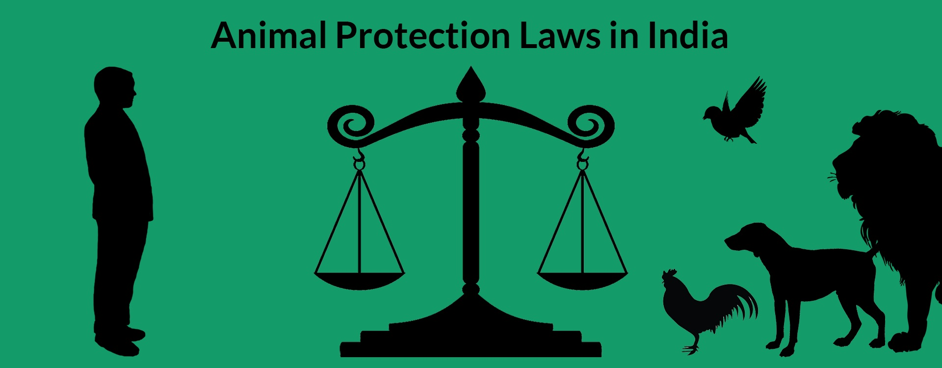
Following is a list of the environmental legislations that have come into effect:
General
Forest and Wildlife
Water
Air

Slide 5

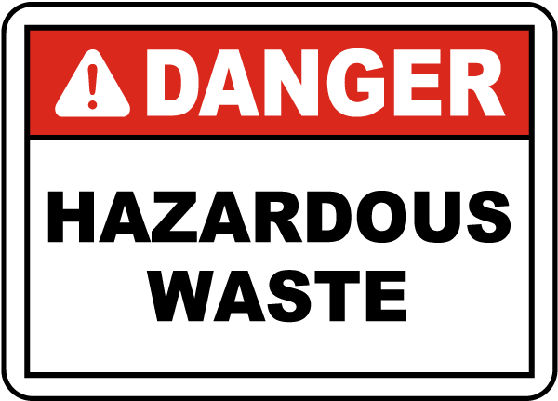
General
1986 - The Environment (Protection) Rules
Standards of emission or discharge of environmental pollutants.
1989 - The objective of Hazardous Waste (Management and Handling) Rules
To control the generation, collection, treatment, import, storage, and handling of hazardous waste.

Slide 6

General
1989 - The Manufacture, Storage, and Import of Hazardous Chemicals
Defines the terms used in this context, and sets up an authority to inspect, once a year, the industrial activity connected with hazardous chemicals and isolated storage facilities.
1992 - The Public Liability Insurance Act and Rules and Amendment
Drawn up for the purpose of providing immediate relief to the persons affected by accident while handling any hazardous substance.

Slide 7
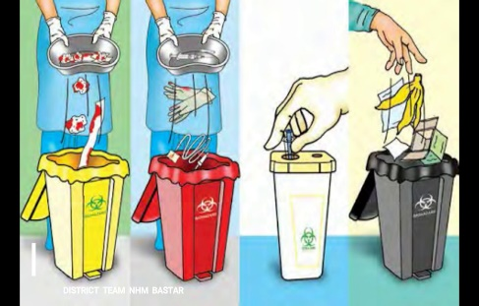
General
1995 - The National Environmental Tribunal Act
Created to award compensation for damages to persons, property, and the environment arising from any activity involving hazardous substances.
1998 - The Biomedical waste (Management and Handling) Rules
Legal binding on the health care institutions to streamline the process of proper handling of hospital waste.

Slide 8
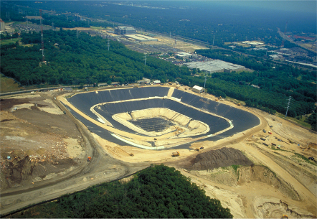
General
1999 - The Environment (Siting for Industrial Projects) Rules, 1999
Lays down detailed provisions relating to areas to be avoided for siting of industries & precautionary measures to be taken for site selection.
2000 - The Municipal Solid Wastes (Management and Handling) Rules, 2000
Apply to every municipal authority responsible for the collection, transportation, processing, and disposal of municipal solid wastes.

Slide 9
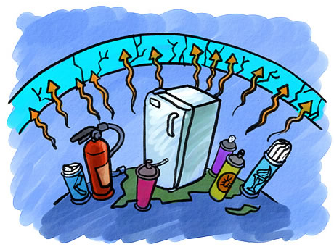
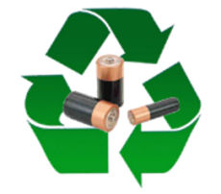
General
2000 - The Ozone Depleting Substances (Regulation and Control)
Rules have been laid down for the regulation of production and consumption of ozone depleting substances.
2001 - The Batteries (Management and Handling) Rules, 2001
Rules shall apply to every person involved in the manufacture, processing, sale, purchase, and use of batteries or components to regulate and ensure the environmentally safe disposal of used batteries.

Slide 10


General
2002 - The Noise Pollution (Regulation and Control) (Amendment)
Lay down terms and conditions as are necessary to reduce noise pollution such as use of loud speakers or public address systems during night hours (from 10.00 p.m. to 6.00 a.m.) on or during any cultural or religious festive occasion.
2002 - The Biological Diversity Act
Is an act to provide for the sustainable use & conservation of biological diversity.

Slide 11


Penalties
Section -15 –EPA deals with these:
If a person fails to comply any provision or any direction issued under this act then he shall be punished for each failure as:-
Imprisonment , which may extend to 5 years, or fine which may extend to Rs. 1 lakh or both.
If failure continues after conviction for 1st failure an additional fine which may be Rs. 5000 for everyday can be imposed.
If failure continues for 1 year the offender shall be imprisoned which may extend up to 7 years.

Slide 12

Forest and wildlife
1927 - The Indian Forest Act and Amendment
It was enacted to ‘consolidate the law related to forest, the transit of forest produce, and the duty leviable on timber and other forest produce’.
1972 - The Wildlife Protection Act
Provides for the protection of birds, animals and plants and for all matter connected there with.

Slide 13
Forest and wildlife
1927 - The Indian Forest Act and Amendment
It was enacted to ‘consolidate the law related to forest, the transit of forest produce, and the duty leviable on timber and other forest produce’.
1972 - The Wildlife Protection Act
Provides for the protection of birds, animals and plants and for all matter connected there with.
1980 - The Forest (Conservation) Act and Rules, 1981
provides for the protection of and the conservation of the forests.

Slide 14
Penalties
Wildlife protection act (9 sept . 1972):
Chapter 6 deals with prevention & detection of offences.
Section 51 deals with penalties:
Any person who contravenes any provision or rule of this act shall be punished with imprisonment for extent of 3 years , or fine extending upto Rs. 25000 or both.
The Indian Forest Act
Under section 33 of this act:
Imprisonment for a term of 6 months or more or fine of Rs. 5,000 or both is the penalty for any person who violates any of the rule under this act.

Slide 15

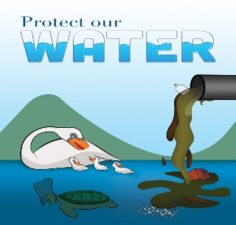
Water
1882 - The Easement Act
Allows private rights to use a resource that is, groundwater, by viewing it as an attachment to the land. It also states that all surface water belongs to the state and is a state property.
1897 - The Indian Fisheries Act
Establishes two sets of penal offences whereby the government can sue any person who uses dynamite or other explosive substance in any way (whether coastal or inland) with intent to catch or destroy any fish or poisonous fish in order to kill.

Slide 16

Water
1956 - The River Boards Act
Enables the states to enroll the central government in setting up an Advisory River Board to resolve issues in inter-state cooperation.
1970 - The Merchant Shipping Act
Aims to deal with waste arising from ships along the coastal areas within a specified radius.
1974 - The Water (Prevention and Control of Pollution) Act
Establishes an institutional structure for preventing and abating water pollution
Establishes standards for water quality and effluent. Central Pollution Control Board was constituted under this act.

Slide 17
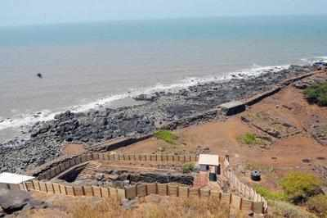

Water
1977 - The Water (Prevention and Control of Pollution) Cess Act
Provides for the levy and collection of fees on water consuming industries and local authorities
1991 - The Coastal Regulation Zone Notification
Puts regulations on various activities, including construction.
It gives some protection to the backwaters and estuaries.

Slide 18
Penalties
Where an offence under this Act has been committed by a company, every person who at the time the offence was committed was in charge of, and was responsible to the company for the conduct of, the business of the company, as well as the company, shall be deemed to be guilty of the offence and shall be liable to be proceeded against and punished accordingly.
Where an offence under this Act has been committed by any Department of Government, the Head of the Department shall be deemed to be guilty of the offence and shall be liable to be proceeded against and punished accordingly.

Slide 19
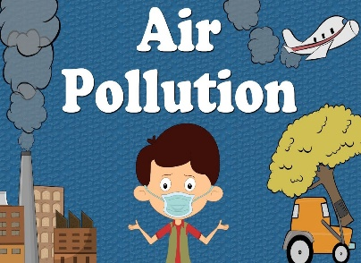
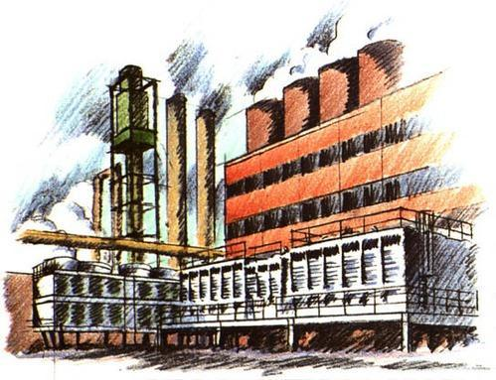
Air
1948 – The Factories Act and Amendment in 1987
First to express concern for the working environment of the workers
1981 - The Air (Prevention and Control of Pollution) Act
Enacted under article 253 of the Indian constitution.
Provides for the control and abatement of air pollution.
1982 - The Atomic Energy Act
Deals with the radioactive waste.

Slide 20

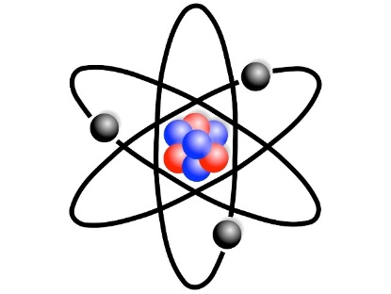
Air
1987 - The Air (Prevention and Control of Pollution) Amendment Act
Empowers the central and state pollution control boards to meet with grave emergencies of air pollution.
1988 - The Motor Vehicles Act
States that all hazardous waste is to be properly packaged, labelled , and transported.
The National Green Tribunal Act, 2010
The Act envisages establishment of NGT in order to deal with all environmental laws relating to air and water pollution, the Environment Protection Act, the Forest Conservation Act and the Biodiversity.

Slide 21
Penalties
Section 37 deals with these:
Punishment for violating any of the rule under this act shall be:
Imprisonment for term which shall not be less than one year or 6 months & may extend to 6 years or with fine.
In case failure continues an additional fine of Rs 500 per day.
If failure continues beyond one year the punishment shall be imprisonment for term which shall not be less then 2 years & may extend to 7 years & with fine.

Slide 22
Environmental Impact Assessment
EIA is a management tool for ensuring optimal use of natural resources for sustainable development.
The MoEF notified new EIA legislation in September 2006.
The notification makes it mandatory for various projects such as mining, thermal power plants, river valley, infrastructure (road, highway, ports, harbours and airports) and industries including very small electroplating or foundry units to get environment clearance.
Certain activities permissible under the Coastal Regulation Zone Act, 1991 also require similar clearance.

Slide 23
Steps involved in EIA
Screening
Scoping
Public Consultation
Appraisal
Post monitoring

Slide 24
Steps involved in EIA
Screening: First stage of EIA, which determines whether the proposed project, requires an EIA and if it does, then the level of assessment required. Categorization of projects.
Scoping: This stage identifies the key issues and impacts that should be further investigated. This stage also defines the boundary and time limit of the study.
Public Consultation: This stage of EIA identifies and predicts the likely environmental and social impact of the proposed project and evaluates the significance.

Slide 25
Steps involved in EIA
Appraisal: The detailed scrutiny by the Expert Appraisal Committee or State Level Expert Appraisal Committee of the application and other documents like the Final EIA report, outcome of the public consultations including public hearing proceedings, submitted by the applicant to the regulatory authority concerned for grant of environmental clearance.
Post monitoring: This stage comes into play once the project is commissioned. It checks to ensure that the impacts of the project do not exceed the legal standards and implementation of the mitigation measures are in the manner as described in the EIA report.

Slide 26
Pollution control boards
The Central Pollution Control Board (CPCB), was constituted in September, 1974 under the Water (Prevention and Control of Pollution) Act, 1974.
Further, CPCB was entrusted with the powers and functions under the Air (Prevention and Control of Pollution) Act, 1981.

Slide 27
Principal Functions of the Pollution Control Board
To promote cleanliness of streams and wells in different areas of the States by prevention, control and abatement of water pollution.
To improve the quality of air and to prevent, control or abate air pollution in the country.

Slide 28
Functions of the Central Pollution Control Board
Advice the Central Government, on any matter concerning the improvement of the quality of air and prevention control or abatement of air pollution/water pollution
Provide technical assistance and guidance to the state boards carry out and sponsor investigations and research relating to problems of air pollution/water pollution and its control and abatement.
Plan and cause to be execute a nation-wide programme through mass media for the provision, control or abatement of air/water pollution.

Slide 29
Functions of the Central Pollution Control Board
Organize through mass media a comprehensive programme towards prevention, control and abatement of air pollution or water pollution.
Collect, compile and publish technical and statistical data relating to air pollution/water pollution and the measures devised for its effective prevention, control and abatement and prepared manuals.
Collect and disseminate information in respect of matters relating to air/water pollution.

Slide 30
Functions of the State Pollution Control Board
To collect information relating water/air pollution and to encourage, conduct, participate in investigations and research relating to problems of water pollutions.
To plan a comprehensive programme through mass media for prevention, control or abatement of air /water pollution.
To advice the Central and State Government, in any matter concerning the prevention, control or abatement of air/water pollution.
To inspect sewage or trade effluents, works and plants for the treatment of sewage or trade effluent.

Slide 31
Functions of the State Pollution Control Board
To evolve economical and reliable methods of effluents of sewage and trade effluents.
To evolve methods of utilization of sewage and suitable trade effluents in agriculture.
To evolve efficient methods of disposal of sewage and trade effluents on land
To lay down standards of treatment of sewage and trade effluents, to be discharged into any particular stream (prevention, control, abatement of discharged of wastes into stream or wells).

Slide 32
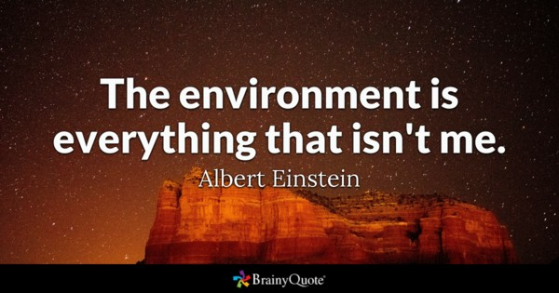
-Thank You!

